Slide 1
Presentation Tips
METIS

Slide 2
Agenda
Content
Slides
Text
Images
Audience
Presentation

Slide 3


CONTENT

Slide 4

Preparation
Most of your work will end
in the cutting room floor
Most of your work will end
in the cutting room floor
Notes:
A lot of the work that you did will not be presented. Get comfortable with that.
https://pixabay.com/en/film-photography-negatives-102681/

Slide 5
What to include?
Introduction
1 slide
Motivation, objectives and goals

Slide 6
What to include?
Introduction
Methodology
1-2 slides
Data, Models, Metrics, Tools

Slide 7
What to include?
Introduction
Methodology
Results
1-2 slides
ROC Curve, Accuracy, $ Saved, Adj. R2, MSE

Slide 8
What to include?
Introduction
Methodology
Results
Conclusions
1 slide
Recommendations, interesting insights

Slide 9
What to include?
Introduction
Methodology
Results
Conclusions
Future Work
1 slide
If you had more time, what else would you do?

Slide 10
What to include?
Introduction
Methodology
Results
Conclusions
Future Work
Appendix
Many slides
Everything else
Notes:
- Introduction (1 slide) – Motivation, Objective, Goal
- Methodology (1-2 slides) – Data, Models, Metrics, Tools
- Results (1-2 slides) – ROC curve, Accuracy, $ Saved
- Conclusions (1 slide) – Recommendation, insights
- Future Work (1 slide)
- Have an Appendix (Backup Slides)!

Slide 11
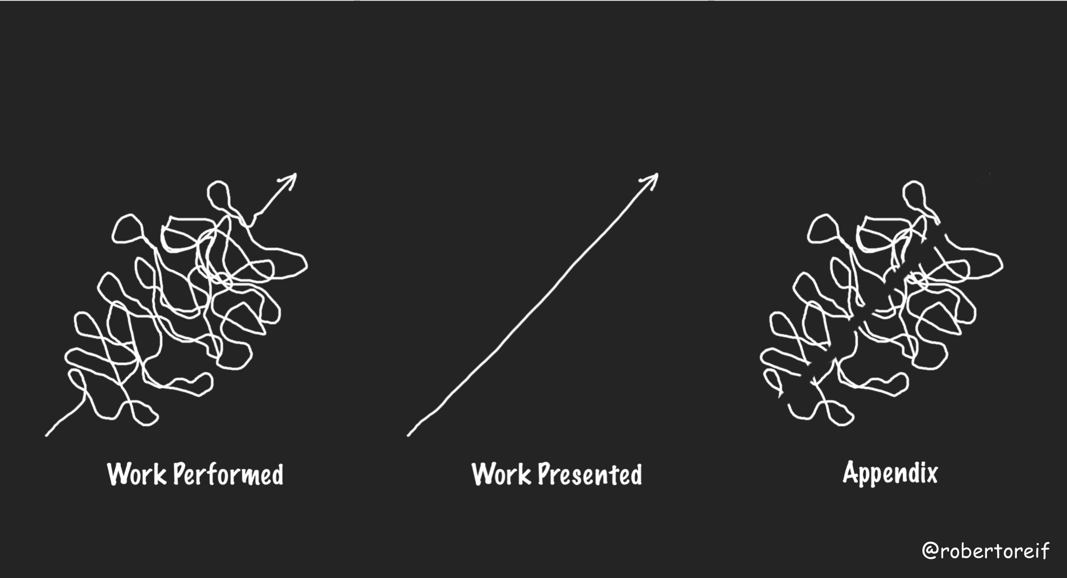
What to include?

Slide 12
SLIDES

Slide 13
Perfection is achieved, not when there is nothing more to add, but when there is nothing left to take away
Antoine de Saint-Exupéry
Notes:
Your slides should include the minimum needed, and nothing else.
Antoine de Saint-Expéry is the author of The Little Prince
https://commons.wikimedia.org/wiki/File:Saint-Exup%C3%A9ry_4.png

Slide 14
Notes:
http://getwallpapers.com/collection/math-equation-wallpaper
Simplify your slides. They should not feel complicated and messy.

Slide 15

$$+ −$$
$$× ÷$$
Notes:
They should feel simple and inviting.

Slide 16
Reading is a Priority
Read the color of the words as fast as you can
Notes:
Test: Prepare students for the challenge on the next slide

Slide 17
Stroop Effect
BLUE GREEN YELLOW
PINK RED ORANGE
GREY BLACK PURPLE
WHITE BROWN BLACK
Notes:
A variation of the Stroop effect demonstrates that naming the color of the word (performing a task) is more challenging than reading. In a similar way, we tend to first read words on the slides than to listen to the speaker.

Slide 18
Reading is a Priority
>
Notes:
Our instinct is to read first over listening or performing other tasks

Slide 19
Bad Slide
Having too much text can be distracting. It is recommended to limit the number of words that are used on each slide. Otherwise, the audience will be reading instead of listening to you. You should not be competing with your slides. A rule of thumb is to use no more than 30 words per slide. However, less is better.

Slide 20
Better
Having too much text can be distracting. It is recommended to limit the number of words that are used on each slide. Otherwise, the audience will be reading instead of listening to you. You should not be competing with your slides. A rule of thumb is to use no more than 30 words per slide. However, less is better.

Slide 21

Best
< 30 words per slide
Notes:
https://pixabay.com/en/books-pages-story-stories-notes-1245690/

Slide 22

Average reading speed
200 words / minute
Notes:
Average reading speed is 200 words/min with a 60% retention
30 words would take 9 seconds from your audience
http://www.readingsoft.com/
https://pixabay.com/en/reading-book-girl-woman-people-925589/

Slide 23
Avoid Unnecessary Animations
PROCESS 1
PROCESS 2
PROCESS 3
Notes:
Avoid distracting animations and slide changes

Slide 24
Better
PROCESS 1
PROCESS 2
PROCESS 3

Slide 25
Better
PROCESS 1
PROCESS 2
PROCESS 3

Slide 26
Better
PROCESS 1
PROCESS 2
PROCESS 3
Notes:
Avoid flashy animations and slide transitions.
Also, present things as you are talking about them.

Slide 27
Align Objects
“One cannot
think well,
love well,
sleep well,
if one has not
dined well.”
Virginia Wolf
Notes:
https://pixabay.com/en/food-kitchen-cook-tomatoes-1932466/
Not good: Object here are not aligned

Slide 28
Align Objects
d
“One cannot
think well,
love well,
sleep well,
if one has not
dined well.”
Virginia Wolf
d
d
d
d
Notes:
https://pixabay.com/en/food-kitchen-cook-tomatoes-1932466/
Better: objects are aligned, have an imaginary border that help guide you.

Slide 29
Slides Summary
Simple
Avoid too much text
Avoid flashy animations and slide transitions
Align objects
Speelchek
1-2 slides per minute
Notes:
Be simple: not a lot of superfluous stuff (don’t add anything unnecessary). Support the speaker, the slide should not be the main point of focus. Have plenty of white space, white space is your friend, Not be cluttered, avoid overwhelming the audience
1-2 slides per minute: more than that does not allow the audience to capture what is being presented in the slide.

Slide 30
TEXT

Slide 31
Font Size
40 point
30 point
20 point
10 point
Notes:
Make sure you pick the right font size

Slide 32
Font Types
Serif Font
Thin
Times
Sans-Serif Font
Thin
Arial
Plain
Strokes have
even width
Serif
Thick and
thin strokes
Notes:
Typically you will have one font for the title and a different font for the body.
Sans serif are easier to read on slides
Serif are easier to read on paper

Slide 33


Fonts can emphasize
Notes:
Top row: Words and font align well.
Bottom row: Words and font contradict each other. Avoid this scenario.

Slide 34
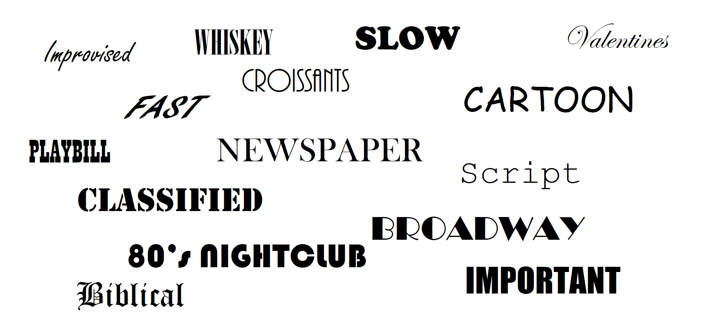
Fonts can emphasize
Notes:
Here we present how words and fonts align. It would not be as impactful to present Classified document with a Broadway font.

Slide 35
Alignment
METIS
83 King Street, Suite 250
Seattle, WA
(555)555-1234
METIS
83 King Street, Suite 250
Seattle, WA
(555)555-1234
Notes:
Centered text is harder to read and looks amateurish. Line up all your text to a right-hand or left-hand baseline – it will look better and be easier to follow.

Slide 36
Contrast
YELLOW TEXT
BLUE TEXT
YELLOW TEXT
BLUE TEXT
Notes:
Find colors for the background and foreground that have good contrast.
Blue and yellow contrast well with the white and black background, respectively.
Blue and yellow do not contrast well with the black and white background, respectively.

Slide 37
Avoid Gradients
THE TEXT CANNOT BE EASILY READ ACROSS ALL COLORS
Notes:
Avoid using color gradients. They create an interesting illusion that can be very distracting.
Notice how difficult it is to read the text across (Note that the font is the same color throughout!)

Slide 38
Text Summary
Appropriate Size
Sans serif fonts for body text
Decorative fonts for headers
Align text left or right
Strong color contrast
Notes:
- Sans serif font for body text. Sans serifs like Arial, Helvetica, or Calibri tend to be the easiest to read on screens.
- Decorative fonts only for slide headers, and then only if they’re easy to read. Decorative fonts –calligraphy, German blackface, futuristic, psychotic handwriting, flowers, art nouveau, etc. – are hard to read and should be reserved only for large headlines at the top of the page. Better yet, stick to a classy serif font like Georgia or Baskerville.
Align text left or right. Centered text is harder to read and looks amateurish. Line up all your text to a right-hand or left-hand baseline – it will look better and be easier to follow.
Contrast: use good contrast between font color and background

Slide 39
IMAGES

Slide 40
PANDA BEAR
Notes:
Low quality image is not good
Avoid clipart
Image Source: https://commons.wikimedia.org/wiki/File:6990634-panda-hug.jpg

Slide 41
PANDA BEAR
Notes:
High quality image is better
Image Source: https://commons.wikimedia.org/wiki/File:6990634-panda-hug.jpg

Slide 42
Images Can Help Emphasize
Strength
Knowledge
Kindness
Notes:
Images can help emphasize. This is a simple boring slide

Slide 43
Images Can Help Emphasize
Strength Knowledge Kindness
Notes:
This slide is more appealing, and more memorable
https://pixabay.com/en/knowledge-book-library-glasses-1052010/
https://pixabay.com/en/yoga-strength-people-woman-2587066/
https://pixabay.com/en/friendship-dog-however-friends-2939535/

Slide 44
AVOID LOW RESOLUTION
Notes:
High quality image is better
https://commons.wikimedia.org/wiki/File:Arcsecant.svg

Slide 45

AVOID LOW RESOLUTION
You can use the following code in Jupyter Notebooks
%config InlineBackend.figure_format = 'svg’, or
fig.savefig(‘filename.svg’, format=’svg’)
Notes:
Avoid jpg

Slide 46
Images Summary
Use high quality images
Avoid clip art
Use images to emphasize
Avoid low resolution images
Use jpgs only for photos
Notes:
People are more likely to take you seriously if your presentation is visually appealing.
Users view attractive design as more usable.

Slide 47
AUDIENCE

Slide 48
Know your audience
Persona
Age
Gender
Education
Income
Race
Religion
Political orientation
etc.
Notes:
How you talk to a room full of medical professionals should be different from the way you address a room full of young entrepreneurs. Everything, should be different. Your topic selection, the language you use, the examples you give to illustrate points, and the little bits of humor included should be tailored specifically with your target audience in mind.

Slide 49
Know your audience
Role
Analyst
Executive
Customer
Technical
Business
Peers
Decision Makers
etc.

Slide 50
Know your audience
Level of Subject Matter Expertise
Novice
User
Expert
Notes:
Provide the right amount of detail
Too much or too little detail are both counterproductive

Slide 51
PRESENTATION

Slide 52
If I had more time I would have written a shorter letter
Winston Churchill
Notes:
It’s hard to be brief! Make sure you dedicate enough time removing anything unnecessary,

Slide 53
Speaking
Vary sentence length
Modulate
Speak slowly – pause often
Speak loud and clear
Do not be condescending
Be energetic
Notes:
Vary sentence length: This makes you sound more interesting and it is easier for your audience to follow. Think short and punchy. Or go long and complex for dramatic effect.
Modulate: Do not speak in monotone for your whole presentation. Be conscious to raise and lower your voice tone. Otherwise people will tune you out.
Speak slowly: you do not want to rush through your presentation

Slide 54
Delivery
Know your stuff
Look at the audience
Do not read from your slides
Rehearse
Don’t go over your allotted time
Avoid verbal tics (ums, ahs)

Slide 55
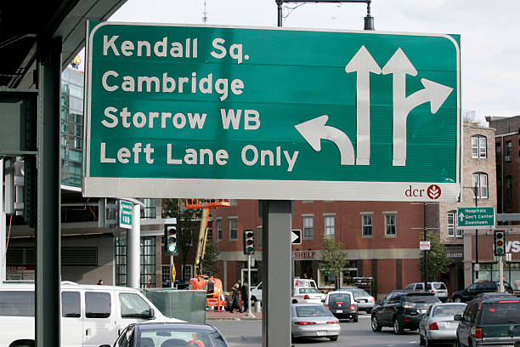
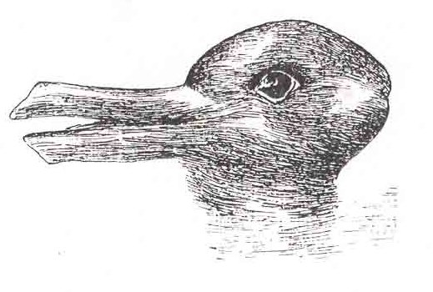
Avoid Ambiguity
Duck or Rabbit?
Which way to Kendall Sq.?
Notes:
Make sure your results are not open to interpretation, but you guide the audience to your conclusions.

Slide 56

Keep it positive
Notes:
Focus on what worked. Do not focus on what did not work (that goes on the appendix)
Discuss the successes. Only focus on the things that don’t work when you don’t think there are results to show (you cannot show there is nothing there, but you CAN show that you looked really hard and that there is unlikely to be a hidden signal)
https://pixabay.com/en/hands-fingers-positive-bracelets-2227857/

Slide 57
Storytelling
Have 1 story (1-3 takeaways)
Assume you are pitching your project to us
We do not need all the details

Slide 58
Motivation
The best stats you’ve ever seen (20 mins)
Hans Rosling
Notes:
Suggested presentation to view on their own time. Great speaker and visualizations.

Slide 59

THANK YOU!

